Slide 1
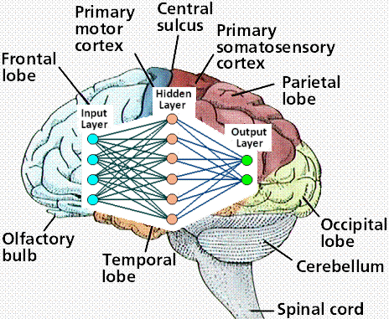
ARTIFICIAL NEURAL NETWORK & FUZZY LOGIC

Slide 2
Introduction to ANN
ANNs as Processing device: are non linear information (signal) processing devices, built from interconnected elementary processing devices c/d neurons.
ANN is a mathematical model: inspired by the way biological nervous systems (BNN -massively large parallel interconnection of large no of neurons), such as brain, process the information. (e.g learning in BNN involves adjustment to synaptic connections that exist b/w the neurons).
A neural network consists of an interconnected group of artificial neurons, and it processes information using a connectionist approach to computation. In most cases a neural network is an adaptive system that changes its structure during a learning phase. Neural networks are used to model complex relationships between inputs and outputs or to find patterns in data.

Slide 3
It is the type of AI that attempts to imitate the way a human brain works. Rather than using digital model (0’s & 1’s), ANN works by creating connections b/w processing elements (neurons eqv.in BNN), the organization and the weights of the connection determine the output.
Resembles brain in two respects:
Knowledge is acquired by the n/w through learning process, and
Inter-neuron connection strengths known as synaptic wts are used to store the knowledge.
Thus ANN is info processing system, where elements c/d neurons that process the information. The signals are transmitted by means of connection links. The links possess an associated weight, which is multiplied along with the incoming signal (input) for any typical neural net. The output signal is obtained by applying activation to net input.
An ANN is typically defined (characterized) by three types of parameters:
Architecture: The interconnection pattern between different layers of neurons
Training or Learning: The learning process for updating the weights of the interconnections
Activation function: That converts a neuron's weighted input to its outputactivation.

Slide 4
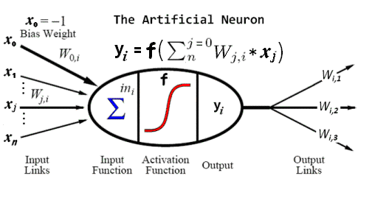
Simple ANN model:

Slide 5
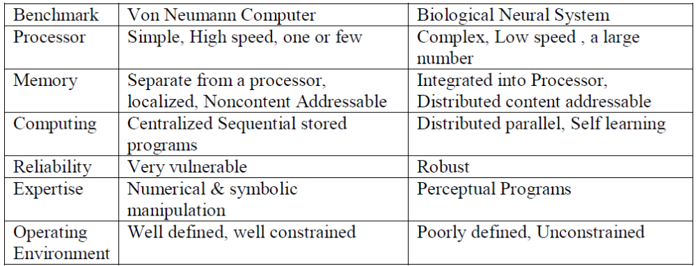
A long course of evolution has given the human brain many desirable characteristics not present in modern parallel computer (Von Neumann architecture) . Such as
Massive parallelism
Distributed representation and computation
Learning ability
Generalization ability
Adaptivity
Inherent contextual info processing
Fault tolerance
Low energy consumption
Von Neumann Computer Vs BNN

Slide 6
Other advantages of ANN:
Adaptive learning
Self organization
Real time operation
Fault Tolerance via redundant info coding
Historical Development of Neural Networks:
1943 – McCulloch & Pitts: start of the modern era of NN. Simple neuron model with logic when net i/p to a particular neuron is greater than specified threshold, the neuron fires. Only binary i/p.
1949 – Hebb’s book “The organization of behaviour”, learning rule for synaptic modification.
1958 - Rosenblatt introduces Perceptron, followed by Minsky & Pappert[1988], the weights on connection path can be adjusted.
1960 – Widrow & Hoff introduce ADALINE, using a learning rule LMS or Delta rule.
1982 - John Hopfield’s networks, type of model to store information in dynamically stable networks.
1972 – Kohonen’s Self Organizing Maps (SOM) capable of reproducing important aspects of the structure of the biological neural nets.
1985 - Parker, Lecum (1986) on BPN and paved its way to NN, generalized delta rule for propagation of error. However credit of publishing this net goes to Rumelhart, Hinton & Williams (1986).

Slide 7
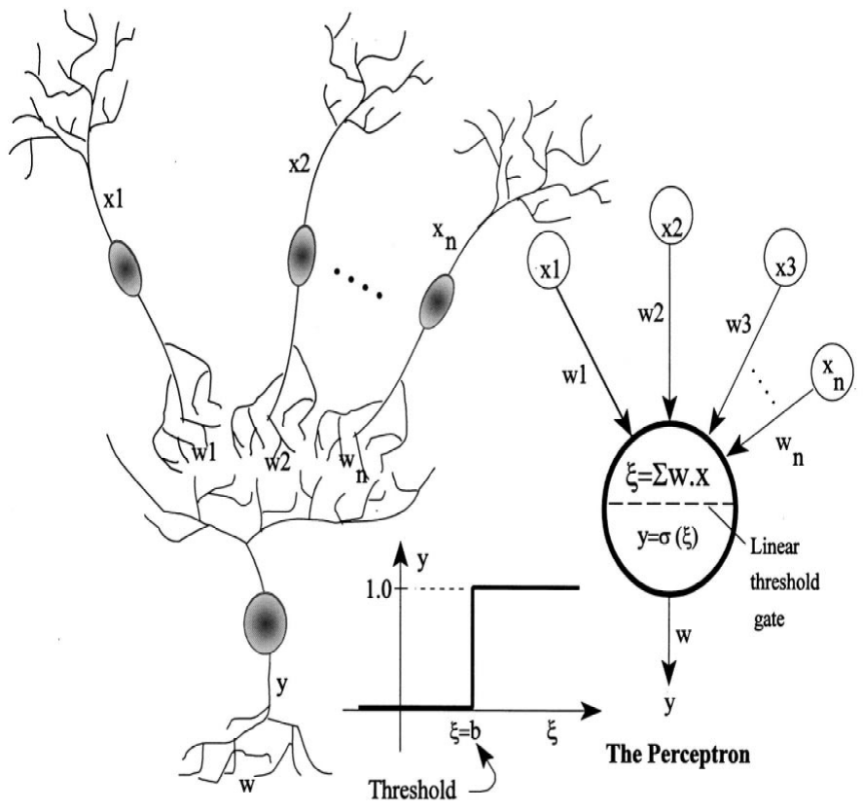
1988 - Grossberg, learning rule similar to that of Kohonen’s, used for CPN, the outstar learning.
1987, 1990 - Carpenter & Grossberg, ART, ART1 for binary ART2 for continuous valued i/p.
1988 - Broomhead & Lowe developed RBF, multilayer similar to BPN.
1990 – Vapnik developed the SVM.
Biological Neural Network (BNN)

Slide 8
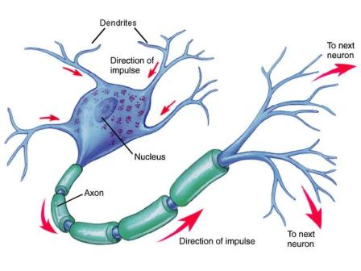
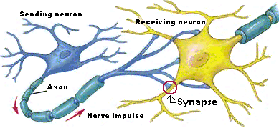
Biological neuron consist of :
Cell body or soma where cell nucleus is located (size: 10-18µm)
Dendrites, tree like nerve fibres associated with soma, which receive signals from other neuron
Axon, extending from cell body, a long fibre which eventually branches into strands & substrands connecting to many other neurons
Synapses, a junction b/w strands of axon of one neuron & dendrites or cell body themselves of other neuron (gap = 200nm)
No of neuron = 10¹¹, interconnection = 10⁴, density = 10¹⁵, length .01mm to 1m(for limb)
Presynaptic terminal
  excitatory
  inhibitory
Transmission of signal -
All nerve cells signal in the same way through a combination of electrical and chemical processes:
Input component produces graded local signals
Trigger component initiates action potential
Conductile component propagates action potential
Output component releases neurotransmitter
All signaling is unidirectional
at a synapse is a complex chemical process, specific transmitter substances are released from sending side of the junction, effect is to raise/lower the electric potential inside the body of receiving cell.

Slide 9
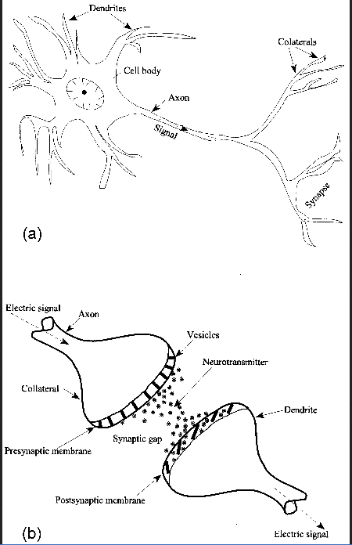
If this potential => threshold, an electric activity (short pulse) is generated. When this happens, cell is said to have fired.
Process:
- in the state of inactivity the interior of neuron, protoplasm is -vely charged against surrounding neural liquid containing +ve sodium ions i.e. Na+ ions.
- the resting potential of about -70mV is supported by cell membrane, which is impenetrable for the Na+ ions . This causes the deficiency of Na+ ions in protoplasm.
- Signals arriving from synaptic connection may result in temporary depolarization of resting potential. When potential is increased to level of above -60mV, the membrane suddenly loses its impermeability against Na+ ions, which enters into protoplasm and reduce the p.d. The sudden change in membrane potential causes the neurons to discharge, the neuron is said to have fired.

Slide 10
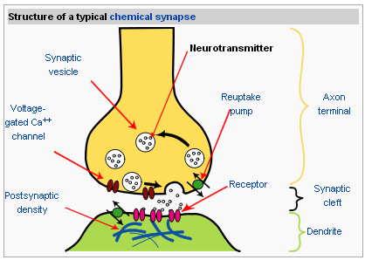
- the membrane then gradually recovers its original properties & regenerate the resting pot. over a period of several milli seconds.
- speed of propagation of discharge signal is 0.5-2m/s, signal travelling along the axon stops at synapse.
- transmission at synaptic cleft is effected by chem. activity, when signal arrives at presynaptic nerve terminal, spl substance c/d neurotransmitter are produced, these molecules travel to postsynaptic within 0.5ms and modify the conductance of postsynaptic membrane causing polarization/depolarization of postsynaptic potential. If polarization pot.is +ve, then synapse is termed as excitatory (tends to activate the postsynaptic neuron) and vice versa inhibitory (counteracts excitation of the neuron)
Neurotransmitter:
Here are a few examples of important neurotransmitters actions:
Glutamate : fast excitatory synapses in brain & spinal cord, used at most synapses that are "modifiable", i.e. capable of increasing or decreasing in strength.
GABA is used at the great majority of fast inhibitory synapses in virtually every part of the brain
Acetylcholine is at the neuromuscular junction connecting motor nerves to muscles.
Dopamine: regulation of motor behavior, pleasures related to motivation and also emotional arousal, a critical role in the reward system; people with Parkinson's disease (low levels of dopamine )

Slide 11
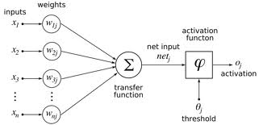
Serotonin is a monoamine neurotransmitter. found in the intestine (approx. 90%), CNS (10%) neurons, to regulate appetite, sleep, memory and learning, temperature, mood, behaviour, muscle contraction, and function of the cardiovascular system
Substance P is an undecapeptide responsible for transmission of pain from certain sensory neurons to the CNS.
Opioid peptides are neurotransmitters that act within pain pathways and the emotional centers of the brain;
Major Elements of BNN
Dendrites : recieves the signal from other neuron (accepts input)
Soma (Cell body): sums all the incoming signals (process the input)
Axon: cell fires, after sufficient amount of input; Axon transmits signal to other cells (turn the processed inputs into outputs)
Synapses: The electrochemical contact between neurons where neurotransmitter have the major role
Dendrites | Synapses | |<---------Cell body---------->| Axon

Slide 12
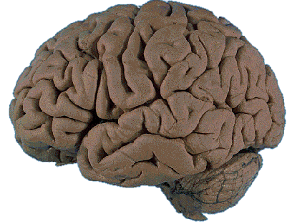
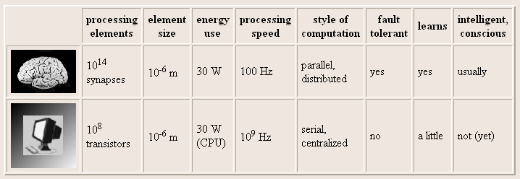
BRAIN COMPUTATION
The human brain contains about 10 billion nerve cells, or neurons. On average, each neuron is connected to other neurons through approximately 10,000 synapses.

Slide 13
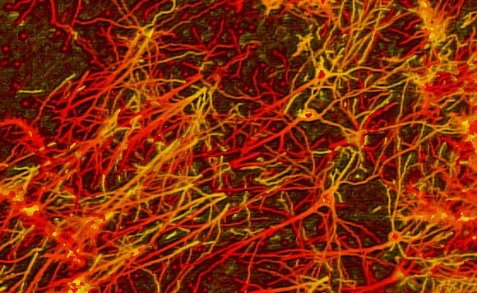
INTERCONNECTIONS IN BRAIN

Slide 14
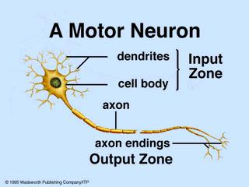
BIOLOGICAL (MOTOR) NEURON

Slide 15
ANN Vs BNN
Characteristics | ANN | BNN
Speed | Faster in processing info; cycle time (one step of program in CPU) in range of nano second | Slow; Cycle time corresponds to neural event prompted by external stimulus in a milli second
Processing | Sequential | Massively parallel operation having only few steps
Size & Complexity | Limited number of computational neuron. Difficult to perform complex pattern recognition | Large number of neurons; the size & complexity gives brain the power of performing complex pattern recognition tasks that can’t be realized on computer
Storage | Info is stored in memory; addressed by its location; any new info in the same location destroy the old info; strictly replaceable | Stores info in strength of interconnection; info is adaptable; new info is added by adjusting the interconnection strength without destroying the old information.
Fault Tolerance | Inherently not a fault tolerant; since the info corrupted in memory can’t be retrieved | Fault tolerant; info is distributed throughout the n/w; even if few connection not works the info is still preserved due to distributed nature of encoded information
Control mechanism | Control unit present; which monitors all the activities of computing | No central control; neurons acts based on local info available & transmits its o/p to the connected neurons

Slide 16
AI Vs ANN
Artificial Intelligence
  Intelligence comes by designing.
  Response time is consistent.
  Knowledge is represented in explicit and abstract form.
  Symbolic representation.
  Explanation regarding any response or output i.e. it is derived from the given facts or rules.
Artificial Neural Network
  Intelligence comes by Training.
  Response time is inconsistent.
  Knowledge is represented in terms of weight that has no relationship with explicit and abstract form of knowledge.
  Numeric representation.
  No explanation for results or output received.

Slide 17
AI Vs ANN
Artificial Intelligence
  Errors can be explicitly corrected by the modification of design, etc.
  Sequential Processing
  It is not a fault tolerant system.
  Processing speed is slow.
Artificial Neural Network
  Errors can’t be explicitly corrected. Network itself modifies the weights to reduce the errors and to produce the correct output.
  Distributed Processing.
  Partially fault tolerant system.
  Due to dedicated hardware the processing speed is fast.

Slide 18
ARTIFICIAL NEURAL NET
W₁
X₁
Y
W₂
X₂
The figure shows a simple artificial neural net with two input neurons (X₁, X₂) and one output neuron (Y). The inter connected weights are given by W₁ and W₂.

Slide 19
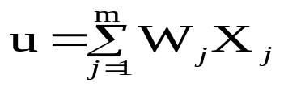

PROCESSING OF AN ARTIFICIAL NET
The neuron is the basic information processing unit of a NN. It consists of:
1. A set of links, describing the neuron inputs, with weights W₁, W₂, …, W_{m}.
2. An adder function (linear combiner) for computing the weighted sum of the inputs (real numbers):
3. Activation function for limiting the amplitude of the neuron output.

Slide 20
BIAS OF AN ARTIFICIAL NEURON
The bias value is added to the weighted sum
∑w_{i}x_{i} so that we can transform it from the origin.
Y_{in} = ∑w_{i}x_{i} + b, where b is the bias
x₁-x₂= -1
x₂
x₁-x₂=0
x₁-x₂= 1
x₁

Slide 21
MULTI LAYER ARTIFICIAL NEURAL NET
INPUT: records without class attribute with normalized attributes values.
INPUT VECTOR: X = { x₁, x₂, …, x_{n}} where n is the number of (non-class) attributes.
INPUT LAYER: there are as many nodes as non-class attributes, i.e. as the length of the input vector.
HIDDEN LAYER: the number of nodes in the hidden layer and the number of hidden layers depends on implementation.

Slide 22
OPERATION OF A NEURAL NET
-
Bias
x₀
w_{0j}
x₁
w_{1j}
∑
f
Output y
x_{n}
w_{nj}
Input
vector x
Weight
vector w
Weighted
sum
Activation
function

Slide 23
WEIGHT AND BIAS UPDATION
Per Sample Updating
updating weights and biases after the presentation of each sample.
Per Training Set Updating (Epoch or Iteration)
weight and bias increments could be accumulated in variables and the weights and biases updated after all the samples of the training set have been presented.

Slide 24
STOPPING CONDITION
All change in weights (Δwij) in the previous epoch are below some threshold, or
The percentage of samples misclassified in the previous epoch is below some threshold, or
A pre-specified number of epochs has expired.
In practice, several hundreds of thousands of epochs may be required before the weights will converge.

Slide 25
BUILDING BLOCKS OF ARTIFICIAL NEURAL NET
Network Architecture (Connection between Neurons)
Setting the Weights (Training)
Activation Function

Slide 26
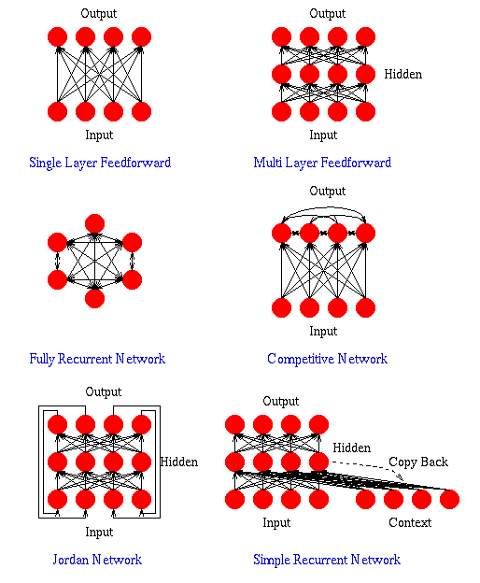

Slide 27
LAYER PROPERTIES
Input Layer: Each input unit may be designated by an attribute value possessed by the instance.
Hidden Layer: Not directly observable, provides nonlinearities for the network.
Output Layer: Encodes possible values.

Slide 28
TRAINING PROCESS
Supervised Training - Providing the network with a series of sample inputs and comparing the output with the expected responses. The training contiues until the network is able to provide the desired response. The weights may then be adjusted according to a learning algorithm.
e.g. Associative N/w, BPN, CPN, etc.
Unsupervised Training - Target o/p is not known. The net may modify the weights so that the most similar input vector is assigned to the same output unit. The net is found to form a exemplar or code book vector for each cluster formed. The training process extracts the statistical properties of the training set and groups similar vectors into classes. e.g. Self learning or organizing n/w, ART, etc.
Reinforcement Training - Right answer is not provided but indication of whether ‘right’ or ‘wrong’ is provided.

Slide 29
ACTIVATION FUNCTION
ACTIVATION LEVEL – DISCRETE OR CONTINUOUS
HARD LIMIT FUCNTION (DISCRETE)
    Binary Activation function
    Bipolar activation function
    Identity function
SIGMOIDAL ACTIVATION FUNCTION (CONTINUOUS)
    Binary Sigmoidal activation function
    Bipolar Sigmoidal activation function

Slide 30
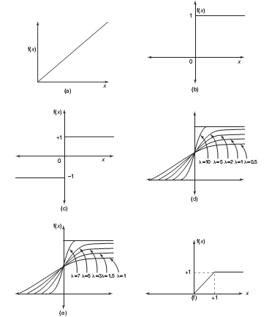
ACTIVATION FUNCTION
Activation functions:
(A) Identity
(B) Binary step
(C) Bipolar step
(D) Binary sigmoidal
(E) Bipolar sigmoidal
(F) Ramp

Slide 31
CONSTRUCTING ANN
Determine the network properties:
  Network topology
  Types of connectivity
  Order of connections
  Weight range
Determine the node properties:
  Activation range
Determine the system dynamics
  Weight initialization scheme
  Activation – calculating formula
  Learning rule

Slide 32
PROBLEM SOLVING
Select a suitable NN model based on the nature of the problem.
Construct a NN according to the characteristics of the application domain.
Train the neural network with the learning procedure of the selected model.
Use the trained network for making inference or solving problems.

Slide 33
NEURAL NETWORKS
Neural Network learns by adjusting the weights so as to be able to correctly classify the training data and hence, after testing phase, to classify unknown data.
Neural Network needs long time for training.
Neural Network has a high tolerance to noisy and incomplete data.

Slide 34
McCULLOCH–PITTS NEURON
Neurons are sparsely and randomly connected
Firing state is binary (1 = firing, 0 = not firing)
All but one neuron are excitatory (tend to increase voltage of other cells)
  One inhibitory neuron connects to all other neurons
  It functions to regulate network activity (prevent too many firings)

Slide 35
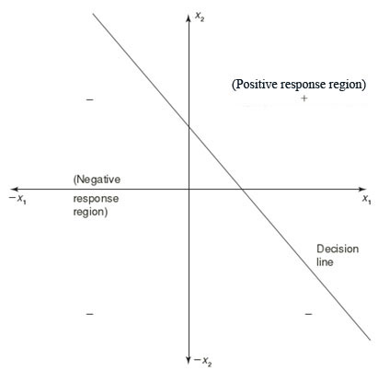
LINEAR SEPARABILITY
Linear separability is the concept wherein the separation of the input space into regions is based on whether the network response is positive or negative.
Consider a network having positive response in the first quadrant and negative response in all other quadrants (AND function) with either binary or bipolar data, then the decision line is drawn separating the positive response region from the negative response region.
“Principles of Soft Computing, 2nd Edition”
by S.N. Sivanandam & SN Deepa
Copyright © 2011 Wiley India Pvt. Ltd. All rights reserved.

Slide 36
HEBB NETWORK
Donald Hebb stated in 1949 that in the brain, the learning is performed by the change in the synaptic gap. Hebb explained it:
“When an axon of cell A is near enough to excite cell B, and repeatedly or permanently takes place in firing it, some growth process or metabolic change takes place in one or both the cells such that A’s efficiency, as one of the cells firing B, is increased.”
“Principles of Soft Computing, 2nd Edition”
by S.N. Sivanandam & SN Deepa
Copyright © 2011 Wiley India Pvt. Ltd. All rights reserved.

Slide 37
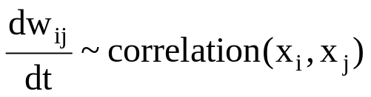
HEBB LEARNING
The weights between neurons whose activities are positively correlated are increased:
Associative memory is produced automatically
The Hebb rule can be used for pattern association, pattern categorization, pattern classification and over a range of other areas.

